Slide 1
Managing Temporary Works Risk
CCG Safety in Design – Practice Forum

Slide 2
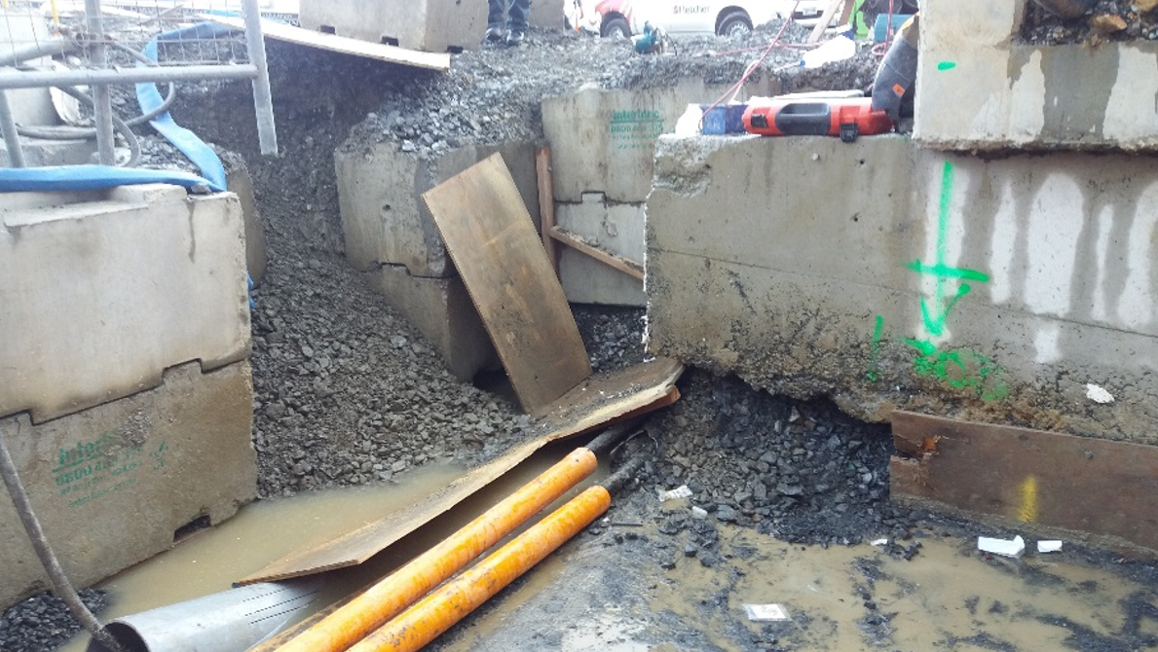
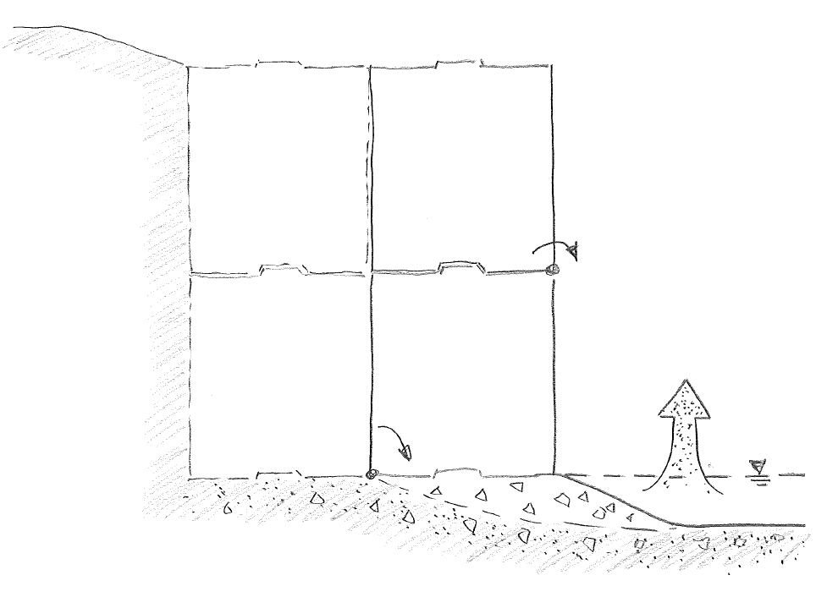

MHX Kirkbride, May 2016 – What happened?
3. Bottom block rotates towards pit, upper block collapses onto IP
2. Ground beneath block becomes loose and is allowed to run into pit

Slide 3
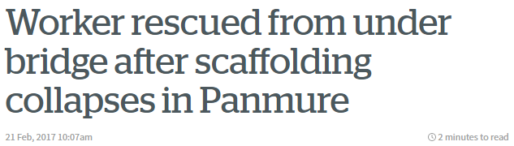
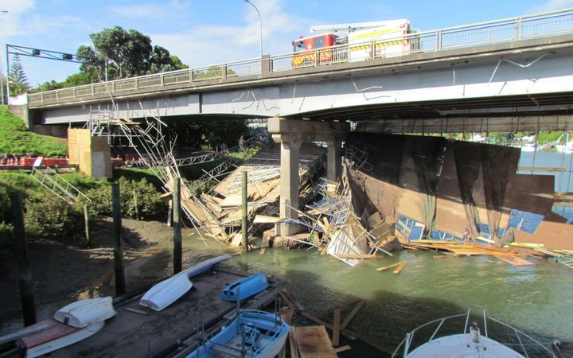
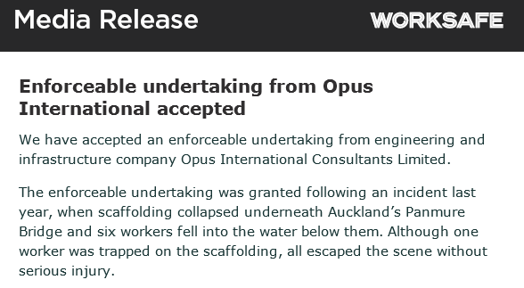
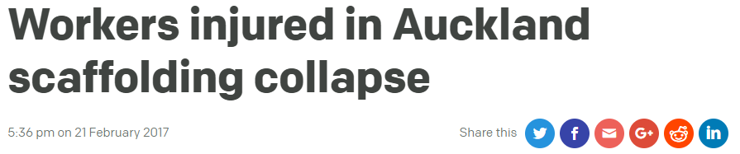

Slide 4

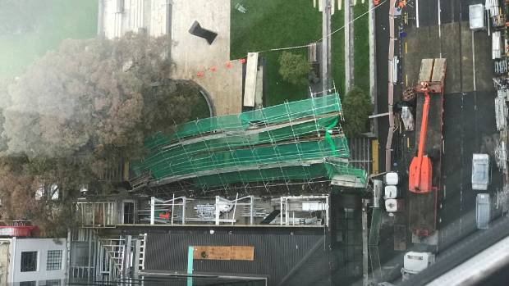
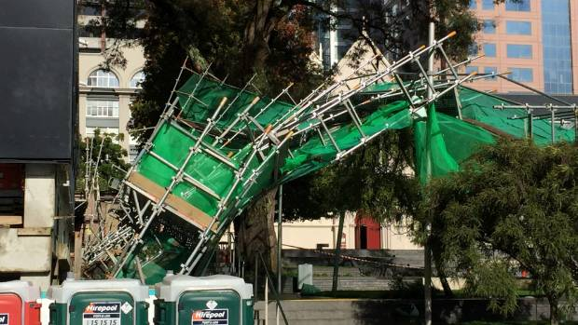
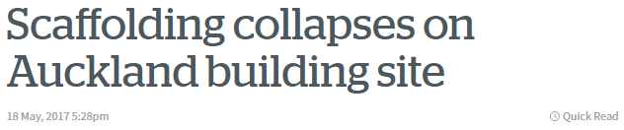

Slide 5
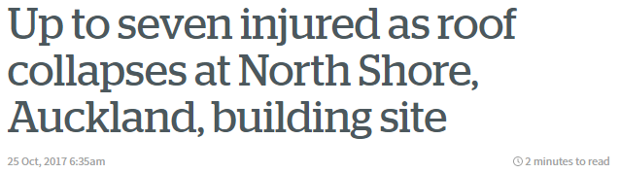
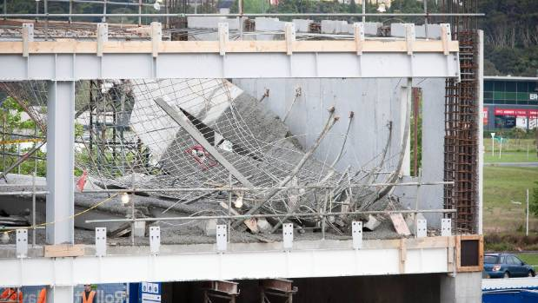


Slide 6

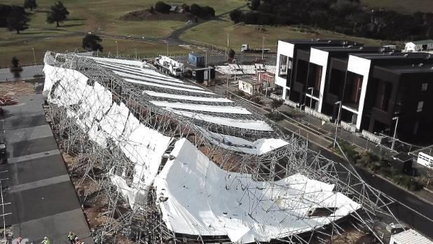
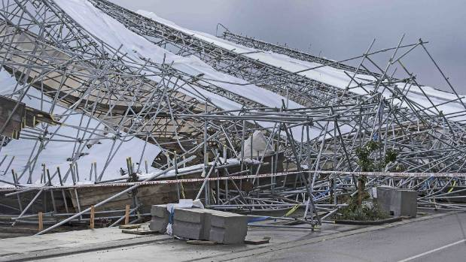
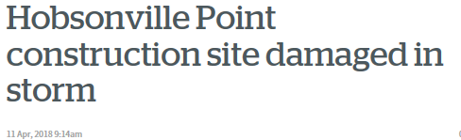

Slide 7
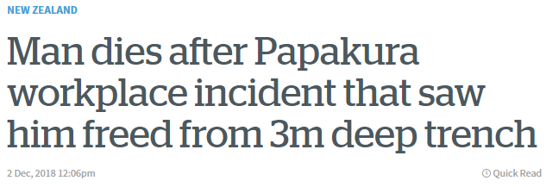
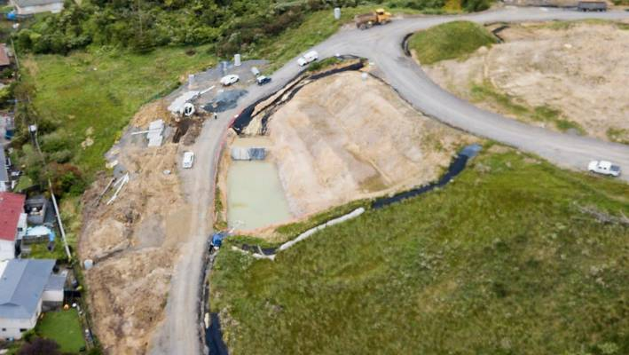
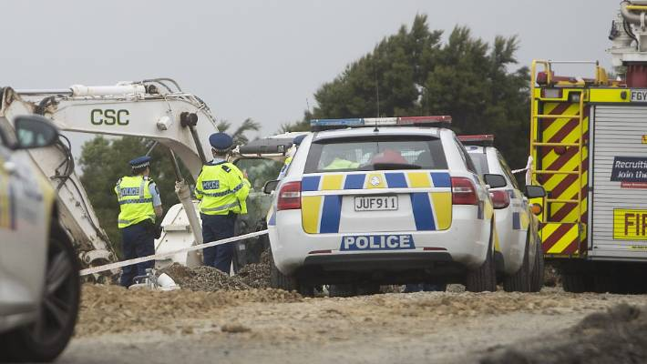
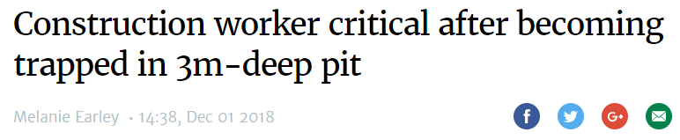

Slide 8
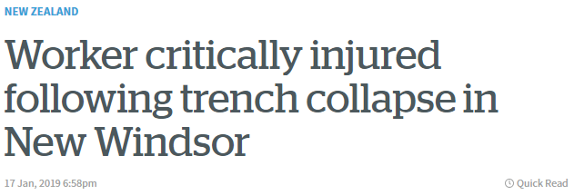
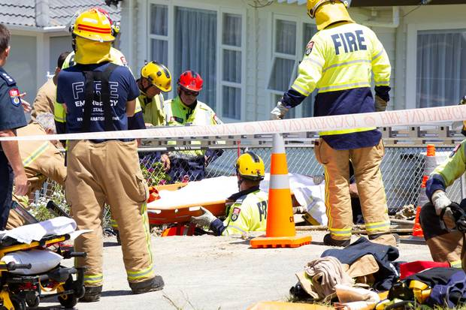
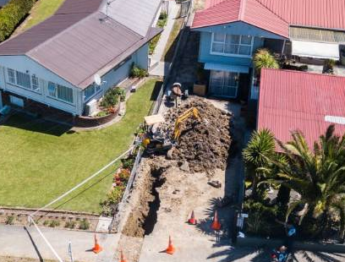
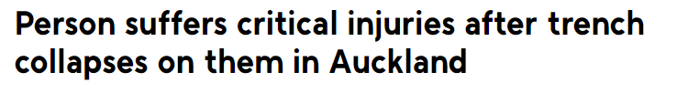

Slide 9






The Temporary Works forum (NZ)
Professional Body
Technical Groups
Special Chapter

Slide 10
The Temporary Works forum (NZ)
What is the main purpose?
... “to encourage open discussion on any matter related to Temporary Works,
for the benefit of the New Zealand Construction Industry.”
Is this a forum just for Engineers?
No, but we are hosted by SESOC as Temporary Works are often specified, designed, checked and controlled by Engineers. No membership required.
What is the meeting format?
To meet every 3-4 months.
Presentations followed by a workshop and networking.
Where?
At the discretion of the committee.
Each meeting will be arranged by and costs sponsored by host organisation.

Slide 11

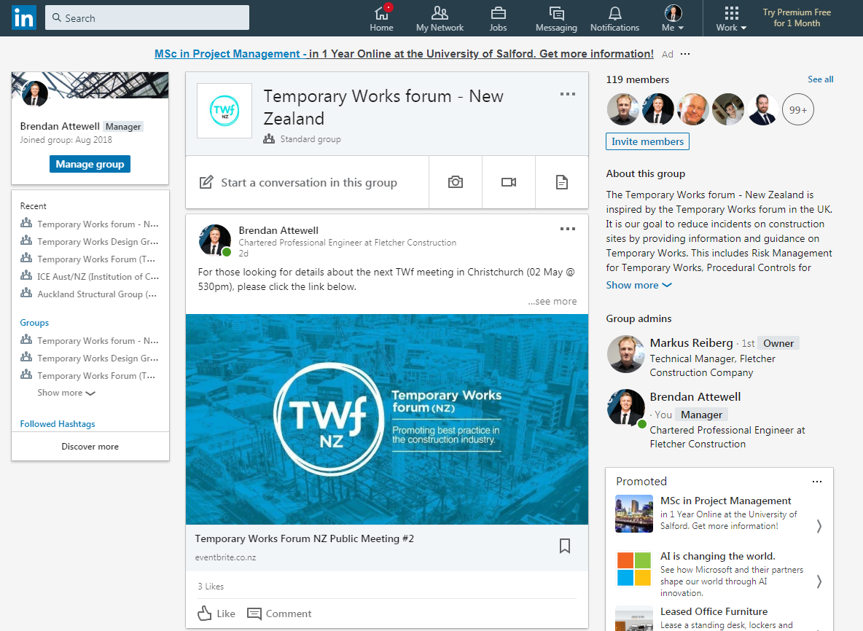
The Temporary Works forum (NZ)
What has been done so far?
www.twf.sesoc.org.nz
(publications, library, links..)
LinkedIn
(coms, help, questions..)

Slide 12
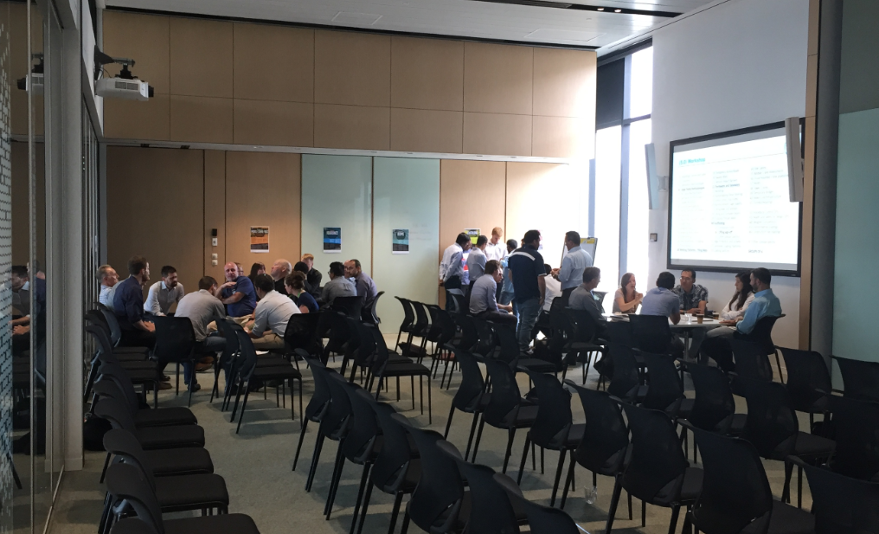
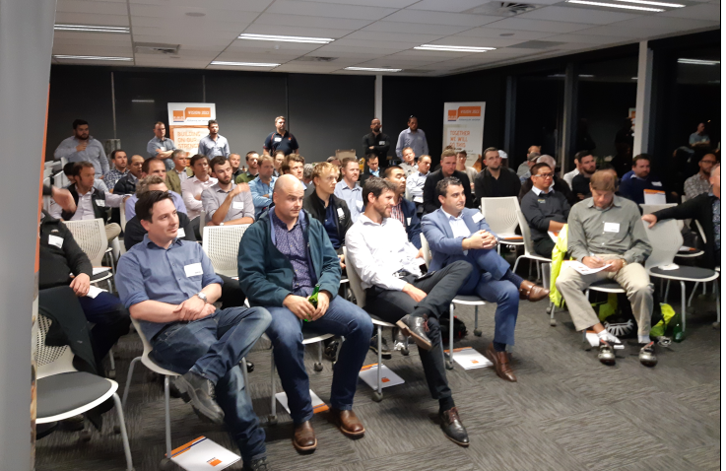
The Temporary Works forum (NZ)
Meetings
Publications
Arrange meetings and seminars | Encourage reasoned debate
Hear from industry experts and opinion formers. Share failures and/or lessons learned. Share knowledge and successes. | Facilitate workshops to understand current issues. Form working groups of members with similar issues. Provide a networking environment.
Good Practice Guides | Guidance Notes (<4 pages) | Safety Posters (A4/A3)
Through the working groups: Research current local practice. Identify international good practice. Develop understanding of the gap in NZ good practice. Engage industry stakeholders towards addressing the gap. Draft a guidance document for consultation. Review comments, adapt and put forward the document to the TWf committee for publication. These guidance docs must be compatible with NZ Standards, recognised GPG’s/ACOP’s, as well as fulfil a gap that otherwise poses an unacceptable risk to the industry.

Slide 13
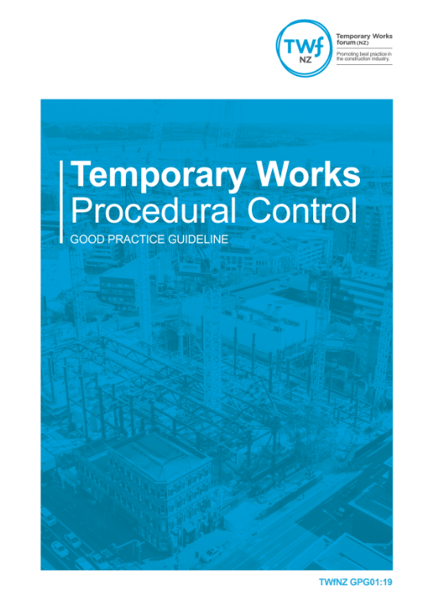


The Temporary Works forum (NZ)
Publications so far..
Published for use
Published April 2019

Slide 14
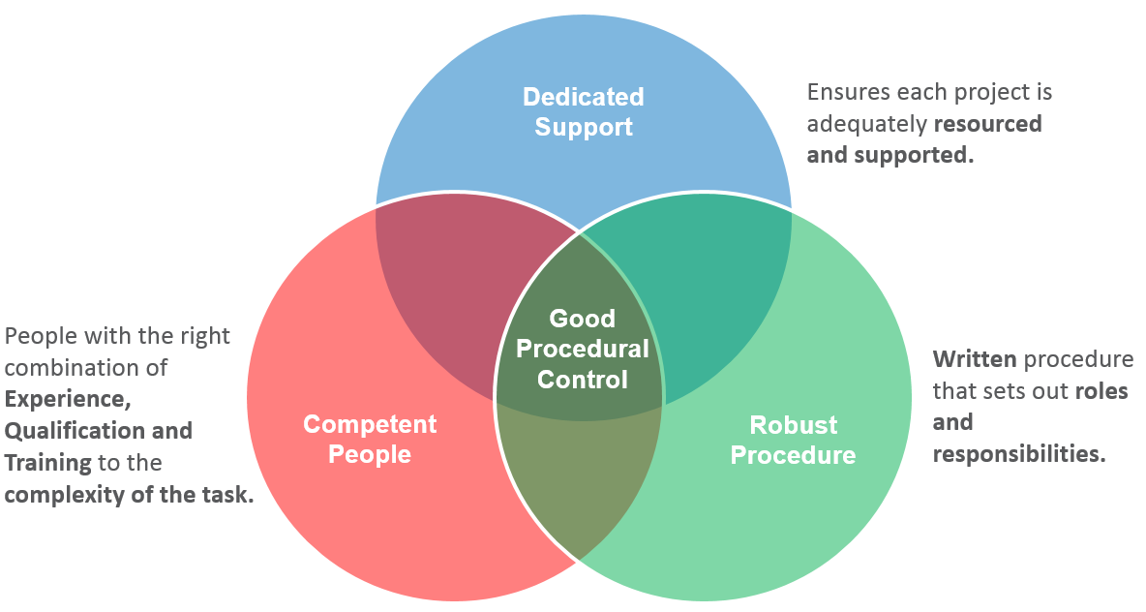
TWfNZ GPG01:19
Written and supported with full appendices so that it can be implemented without further development.

Slide 15
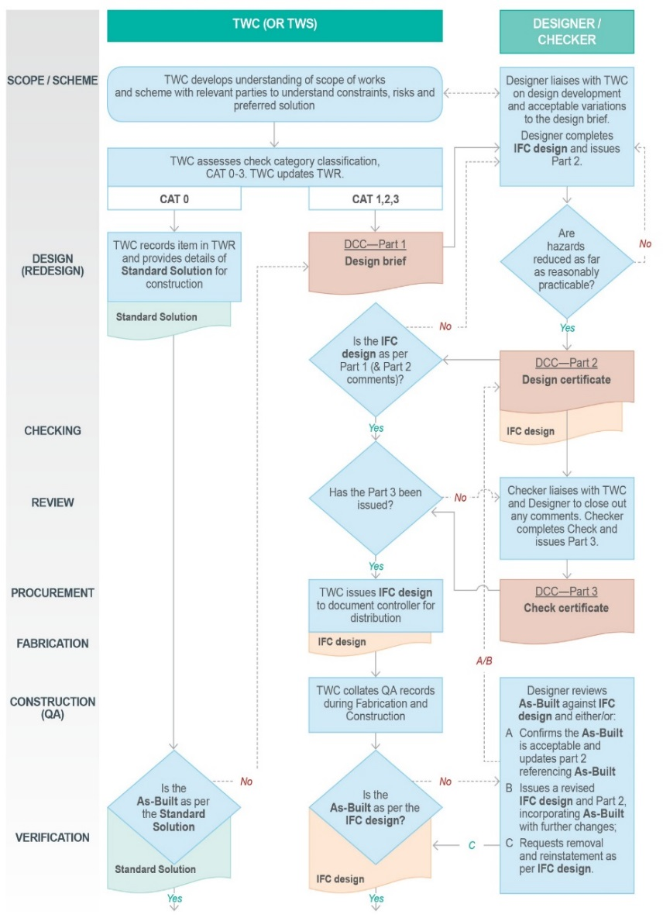
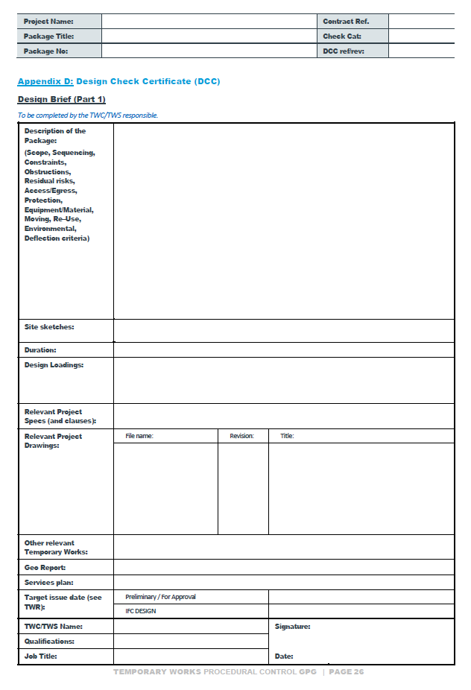
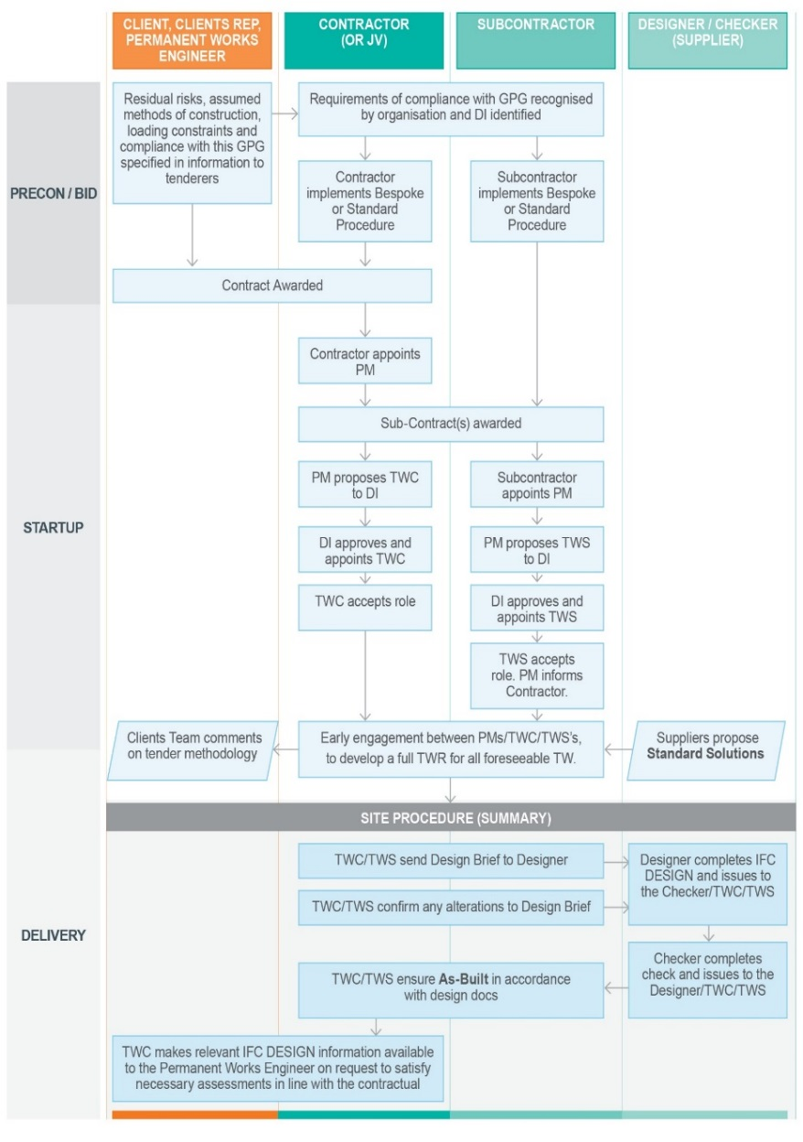
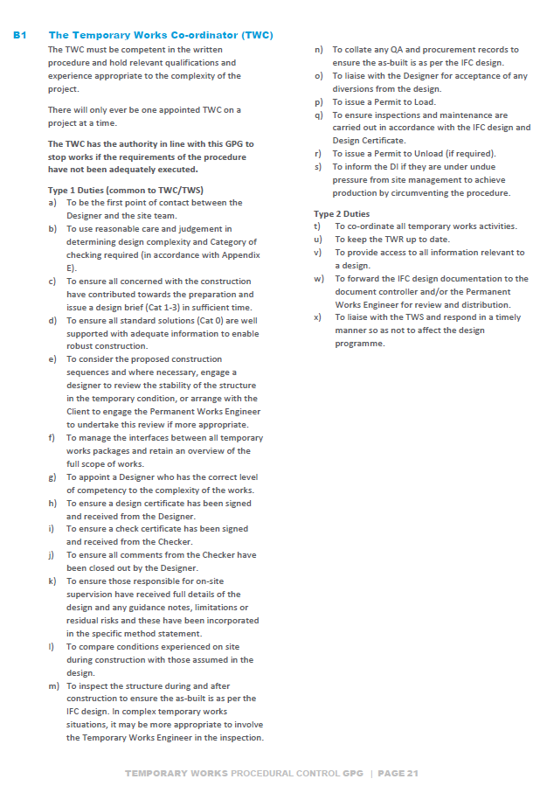
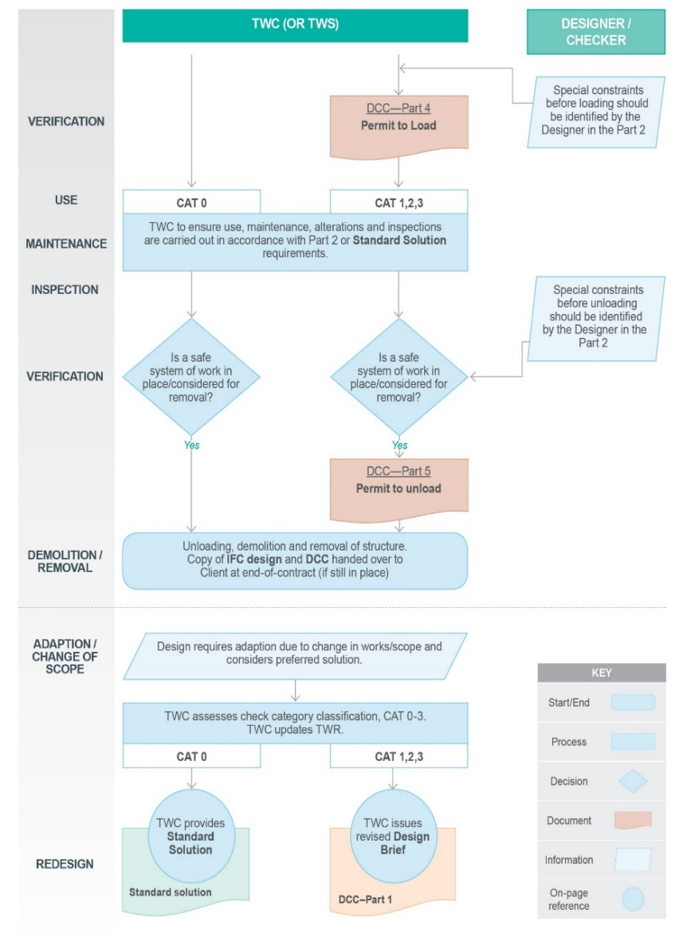
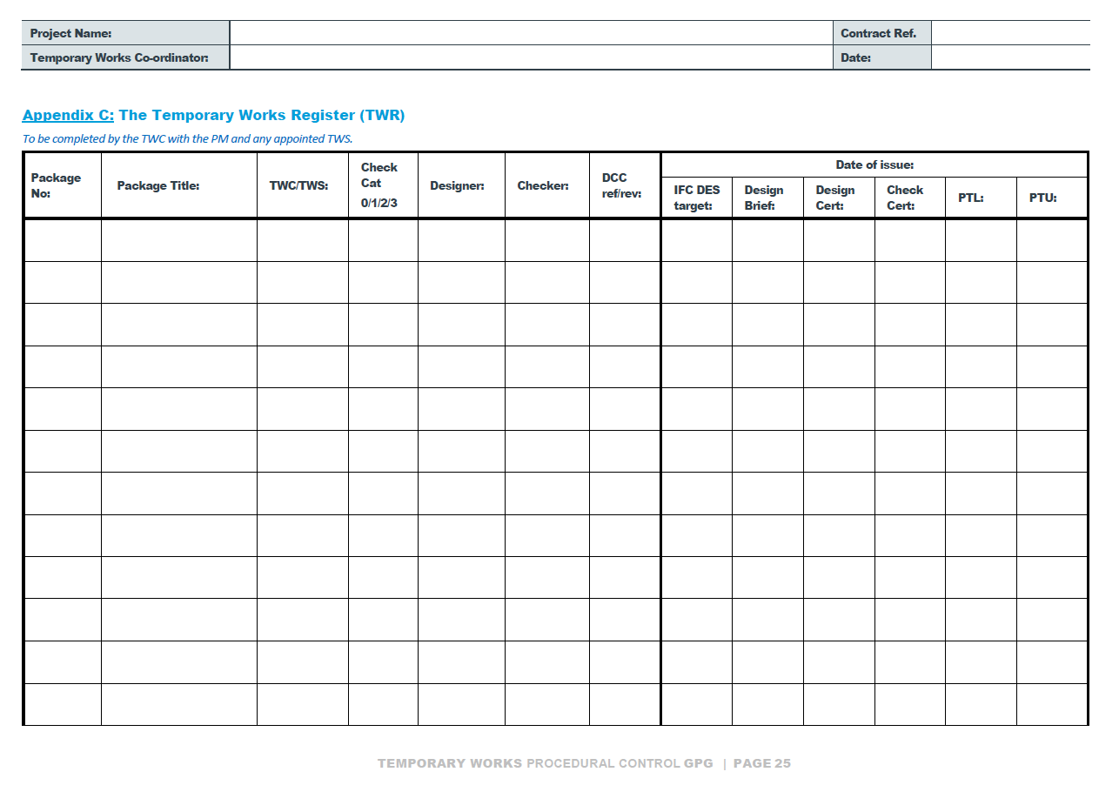
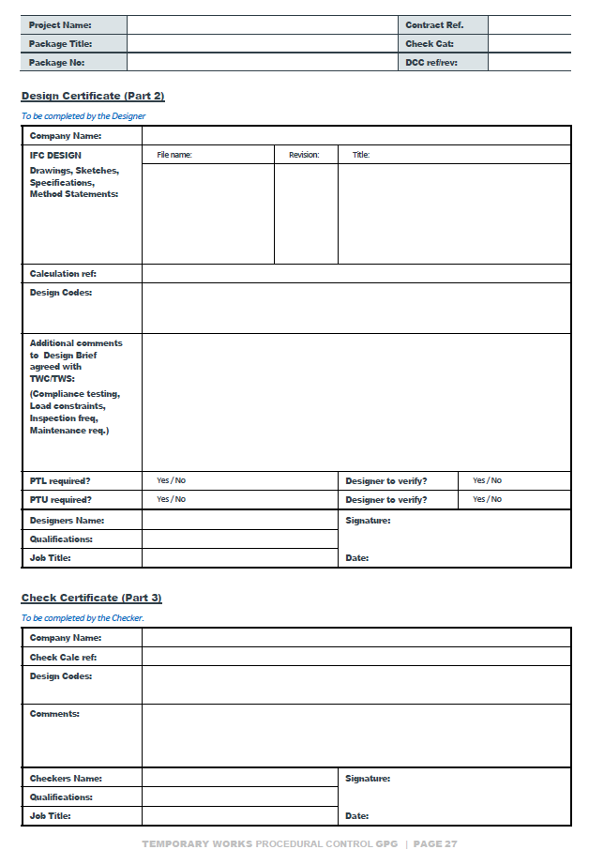
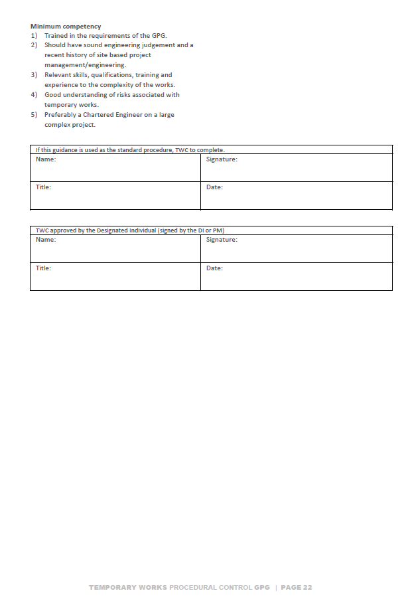
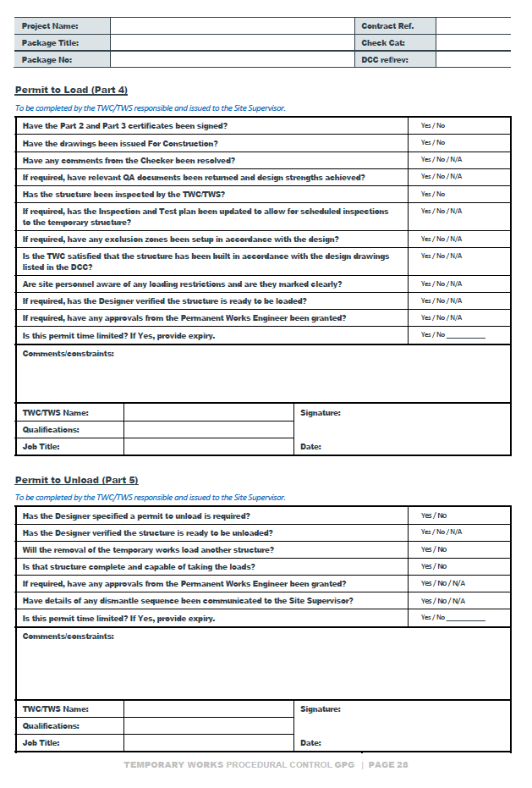
TWfNZ GPG01:19 (Appendices)

Slide 16
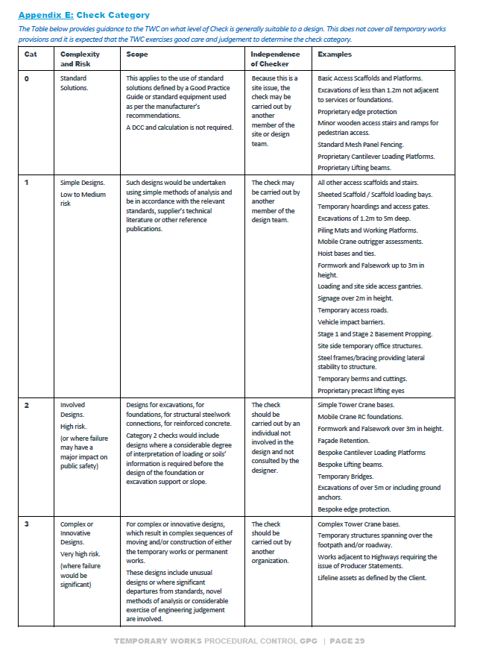
TWfNZ GPG01:19 Check Category (Appendix E)
0: Standard solutions
Basic scaffolds, Proprietary edge protection, Mesh panel fencing, Proprietary lifting beams, Excavations using standard trench shields, in line with Manufacturers recommendations or Good Practice Guides (i.e. No design required).
1: Simple designs
Formwork and Falsework, Shallow Excavations and trenches, Hoardings, Mobile Crane Assessments, Temporary berms.
2: Involved designs
RC Tower Crane bases, Hoist bases and ties, Façade Retentions, Deep Excavations
3: Complex or Innovative designs
Steel grillage Tower Crane bases, Complex construction of demolition methodologies.

Slide 17
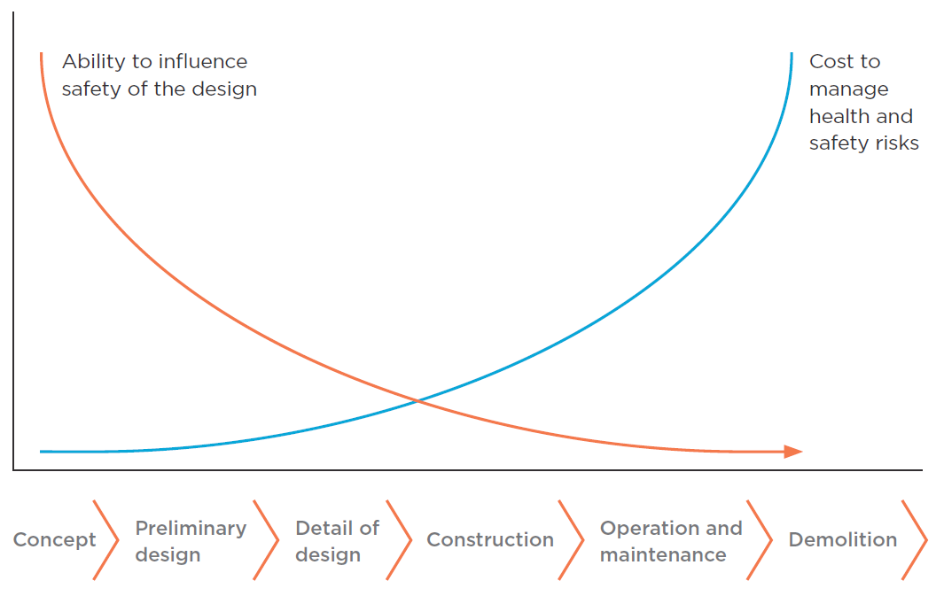

The Temporary Works forum (NZ)
Where to from here?
Guidance Note:
Early focus on Constructability and Temporary Works (?)
+ Working Groups
Scaffold CPEng sign-off
Working Platform cert
Steel frame method.
Formwork/Falsework

Slide 18
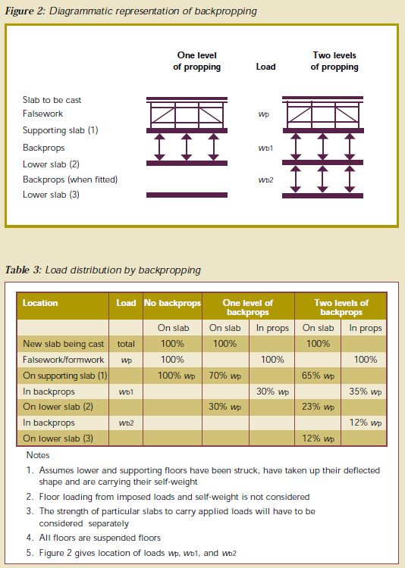
e.g. Load distribution by backpropping
Floor design loads
Live Load = 1.5 kPa
Superimposed Dead Load = 0.5 kPa
TOTAL Design Load = 2.0 kPa
Construction Live Loads
Slab dead weight = 3.6 kPa
Wt. of Falsework = 1.5 kPa
Live load = 0.75 kPa
TOTAL CLL = 5.85 kPa
CLL > Design Load; backprop floors
Conventional method (NZ)
Based on BS5975:1996
Load spread evenly through all floors.
On support slab (1) = 33% = 1.95 kPa
On support slab (2) = 33% = 1.95 kPa
On support slab (3) = 33% = 1.95 kPa
Applied load < Design Load; OK
Revised method
Based on BS5975:2008
From testing: load spread is uneven.
On support slab (1) = 65% = 3.80 kPa
On support slab (2) = 33% = 1.34 kPa
On support slab (3) = 33% = 0.72 kPa
Applied load > Design Load; NOT OK
???

Slide 19

TEMPORARY WORKS:
Risk and awareness
CHRISTCHURCH – 19 JUN 2019
WHANGAREI – 24 jul 2019
wellington – 15 aug 2019
Auckland – 18 sep 2019
TEMPORARY WORKS
CO-ORDINATOR
CHRISTCHURCH – 20 JUN 2019
WHANGAREI – 25 jul 2019
wellington – 16 aug 2019
Auckland – 19 sep 2019
For more information on temporary works practice in New Zealand,
please see the TWf webpage www.twf.sesoc.org.nz

